Slide 1
DECISION TREES AND RANDOM FOREST classifier
Name: Yash Wadhwa
NUID: 002778382

Slide 2
Technical approach:
Loaded the "Loan" dataset.
Dropped the Decision column from the dataset.
Using pd.get_dummies on certain columns in the data frame X, creating a new data frame X_encoded with binary values indicating the presence or absence of each category in the original data.
On splitting the data into two sets for training and testing, we created a variable, "y_pred" to predict on the testing set of X to assess the accuracy w.r.t. the dataset "y_test".

Slide 3
Result:
For Decision Trees:
Using Gini Index: We achieved an accuracy of 0.66.
Using Entropy based Information Gain: We achieved an accuracy of 0.72.
For Random Forest:
Using Gini Index: We achieved an accuracy of 0.80.
Using Entropy based Information Gain: We achieved an accuracy of 0.80.

Slide 4
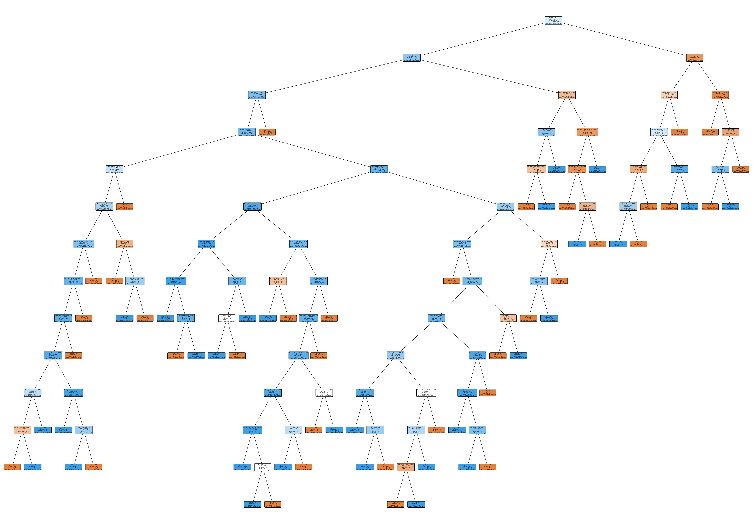
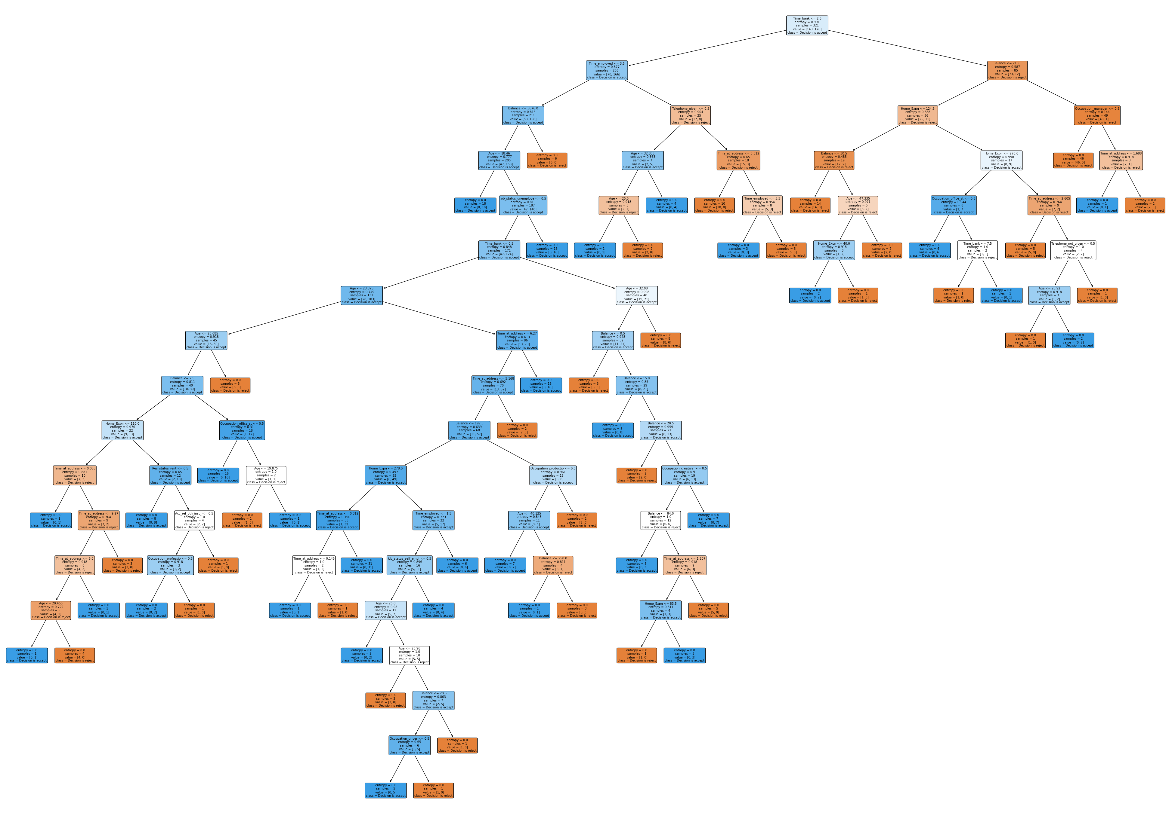
Decision trees
Using Gini Index
Using Entropy based Information Gain

Slide 5
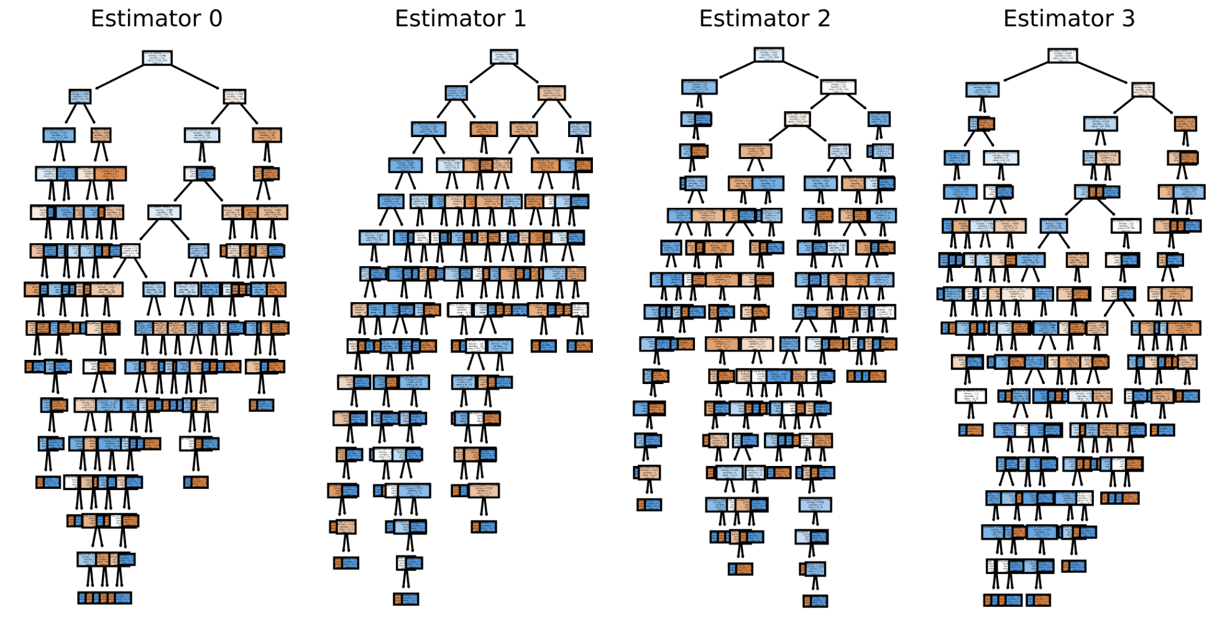
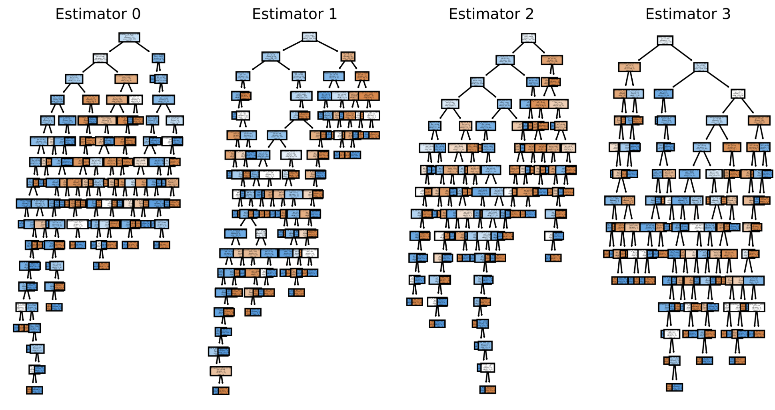
Random forest
Using Entropy based Information Gain
Using Gini Index

Slide 6
Conclusion
In this assignment, we showed the effectiveness of decision tree classifiers and random forests for data analysis.
The implementation in Python, evaluation of their performance, and visualization of the learned model showcased their potential for providing accurate and insightful predictions.
Furthermore, we can conclude that by aggregating the predictions of multiple decision trees, random forests provide a more robust and reliable model and hence improved accuracy.

Slide 7
Thank you!

